Slide 1
Azure AD Application Proxy
M365 – MS 100
Notes:
Importance planning

Slide 2
Topics
What is Azure AD Application Proxy
Demo: How you can Setup Azure AD proxy
Notes:
Picture

Slide 3
Azure AD Application proxy
Azure AD application proxy is to provide secure remote access to the on-premises web application.
Simple to Use
Secure
Cost Effective
Notes:
Picture

Slide 4
Application proxy works with
Web application that uses integrated windows authentication for authentication...
web application that use form based or header-based access
Web APIs that you want to expose to a rich application on different devices.
Applications hosted behind a Remote Desktop Gateway
Notes:
Picture

Slide 5
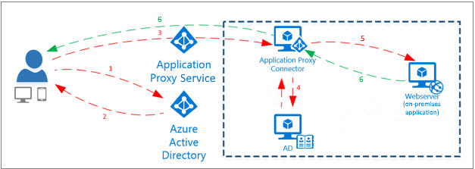
How Application proxy works
Step 1: User Sign in page (Microsoft)
Step 2: Azure AD Send token to user device
Step 3: Device send token to Application proxy, proxy then send the UPN and SPN to Application proxy connector
Step 4: Additional Authentication
Step 5: Proxy connector send request to the on-premises App
Step 6: A response is sent through the connector and application proxy service to the user
Notes:
Picture

Slide 6
Requirements
Azure AD Requirements
Azure AD premium subscription
Application administrator credentials
User identity must be synchronised
On-premises Requirements
Windows Server 2012 R2 or later
TLS 1.2
Open Ports 80 and 443
Let us have a look at these first.

Slide 7
Next Video
Azure AD Application proxy
How Azure AD Application proxy works
Demo: Azure AD Application proxy
Summary
Demo: Add Azure AD Gallery application

